Slide 1

Exploratory Data Analysis
G2M Case Study
21-Aug-2023

Slide 2

Agenda
Executive Summary
Problem Statement
Approach
EDA
Conclusion and Recommendations

Slide 3
Executive Summary
XYZ is a private firm in US. Due to remarkable growth in the Cab Industry in last few years and multiple key players in the market, it is planning for an investment in Cab industry and as per their Go-to-Market(G2M) strategy they want to understand the market before taking final decision.
To make a decision between two important cab companies (Yellow Cab and Pink Cab) in which to invest, we used Exploratory Data Analysis to identify important aspects of the market and each individual company.
After analyzing data from four different datasets, 359 thousand rows of data and 16 different features on a timeframe of three years (2016-2018), Yellow Cab seems to excel in most aspects financially, which was our final recommendation for investment.

Slide 4
Problem Statement
XYZ is a private firm in US. Due to remarkable growth in the Cab Industry in last few years and multiple key players in the market, it is planning for an investment in Cab industry and as per their Go-to-Market(G2M) strategy they want to understand the market before taking final decision.
Two main cab companies are in debate for investment: Yellow Cab and Pink Cab, where data on each transactions’ price charged and cost, customer background, market share by city, and payment mode exists for the years 2016 to 2018.

Slide 5
Problem Statement
The questions we aim to answer to make a decision are the following:
Is there seasonality in number of customers using cab service by company?
How does the proportion of users per company compare to the total amount of users in each city?
How do the profits of Yellow Cab and Pink Cab fluctuate with time and City?
How does Kilometers Travelled affect that trip's price charged and cost incurred?
What is the ratio of price charged per km and profit per km travelled in each company?
Which company the customers with the highest income use? Do these tend to pay in cash or card?
Do the companies make bigger profit when they are paid with cash than with card?

Slide 6
Approach
The questions will be answered using Exploratory Data Analysis consisting of preliminary table exploration and merging, some necessary table calculations and transformations, and exploratory data visualizations.

Slide 7
Exploratory Data Analysis
Preliminary table exploration
Our data consists of four separate tables, with dates from 01/01/2016 – 30/12/2018:
Dataset | Observation # | Feature # | Description
Cab_Data.csv | 359,392 | 7 | General transaction-specific data.
Transaction_ID.csv | 440,098 | 3 | Link table to Customer ID and contains payment mode.
Customer_ID.csv | 49,171 | 4 | Contains customer-specific data.
City.csv | 20 | 3 | Contains city population and user amount data.
Merged into one:
Dataset | Observation # | Feature # | Description
Final data | 359,392 | 16 | Merged dataset including new feature calculations.

Slide 8
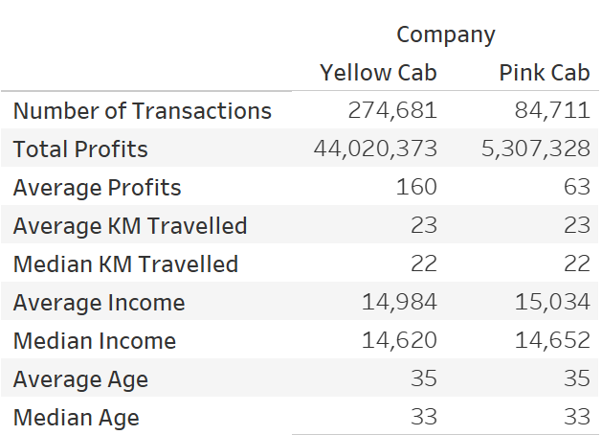
Exploratory Data Analysis
Initial Feature Exploration
It is clear Yellow Cab makes a lot more transactions than Pink Cab, as well as holds better profit margins on average and total. Other key variables such as kilometer travelled and customer income and age do not seem to vary much, if at all, however.

Slide 9
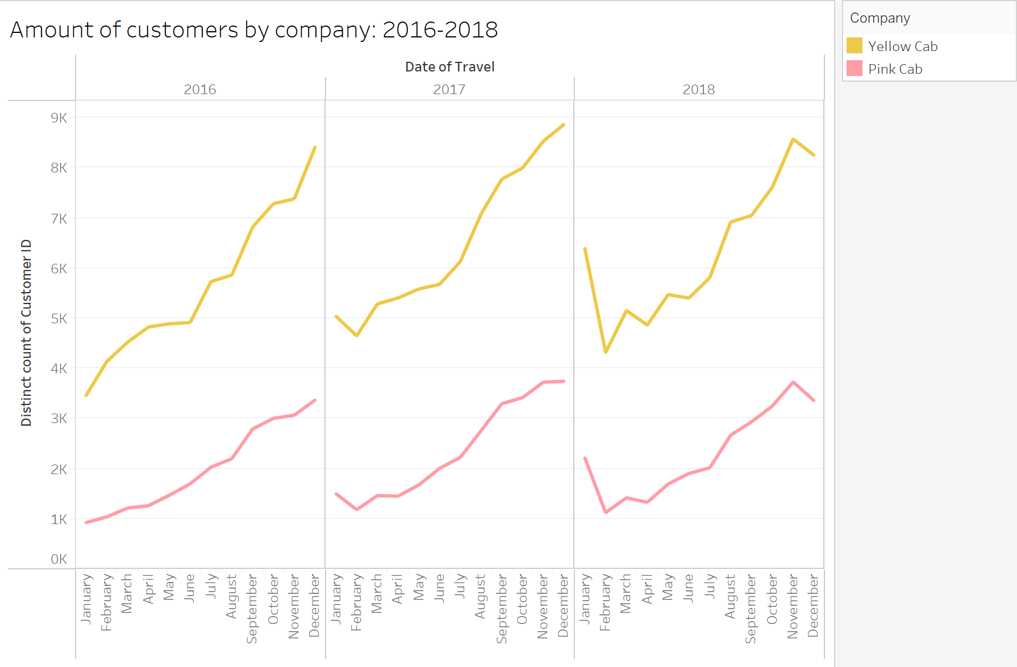
Exploratory Data Analysis
Company market share
With our three-year timeframe, there appears to be a noticeable seasonality in customer demand of both taxi services, with the number of customers dropping every new year, and increasing until they peak near the end of each year. Most likely a Christmas phenomena. The process is the same for both companies, and thus Pink Cab remains on static distance under Yellow Cab.

Slide 10
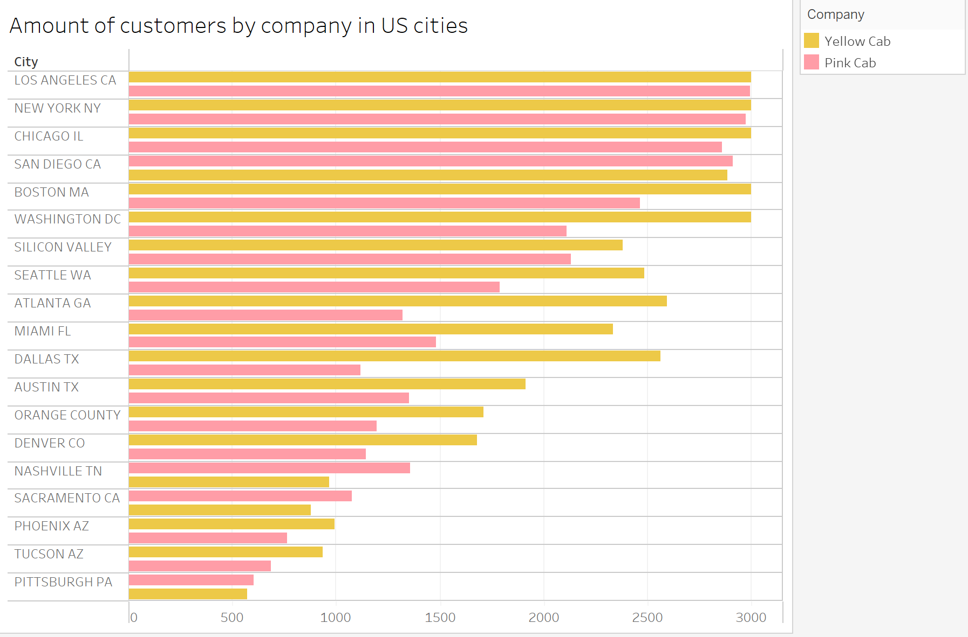
Exploratory Data Analysis
Company market share
Yellow Cab has a higher Consumer base in almost all of the explored cities, with Pink Cab having a higher market share in Nashville, Sacramento, San Diego and Pittsburgh.

Slide 11
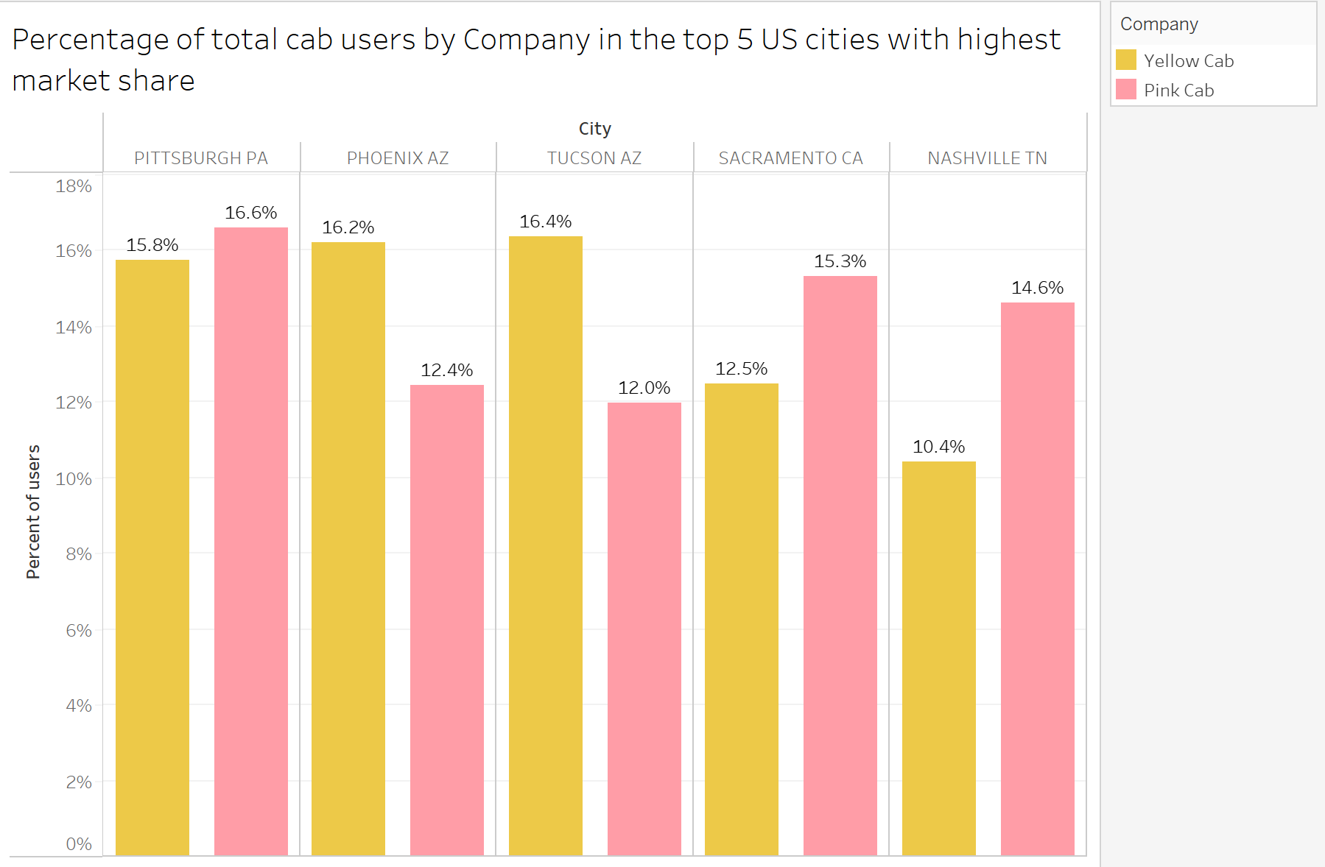
Exploratory Data Analysis
Company market share
Despite this, however, three of these cities are also in the top 5 cities where the companies' market share when compared to the rest of the industry is higher. Although Yellow Cab has the upper hand on the more populated cities, it is a very small percentage of the total amount of users.

Slide 12
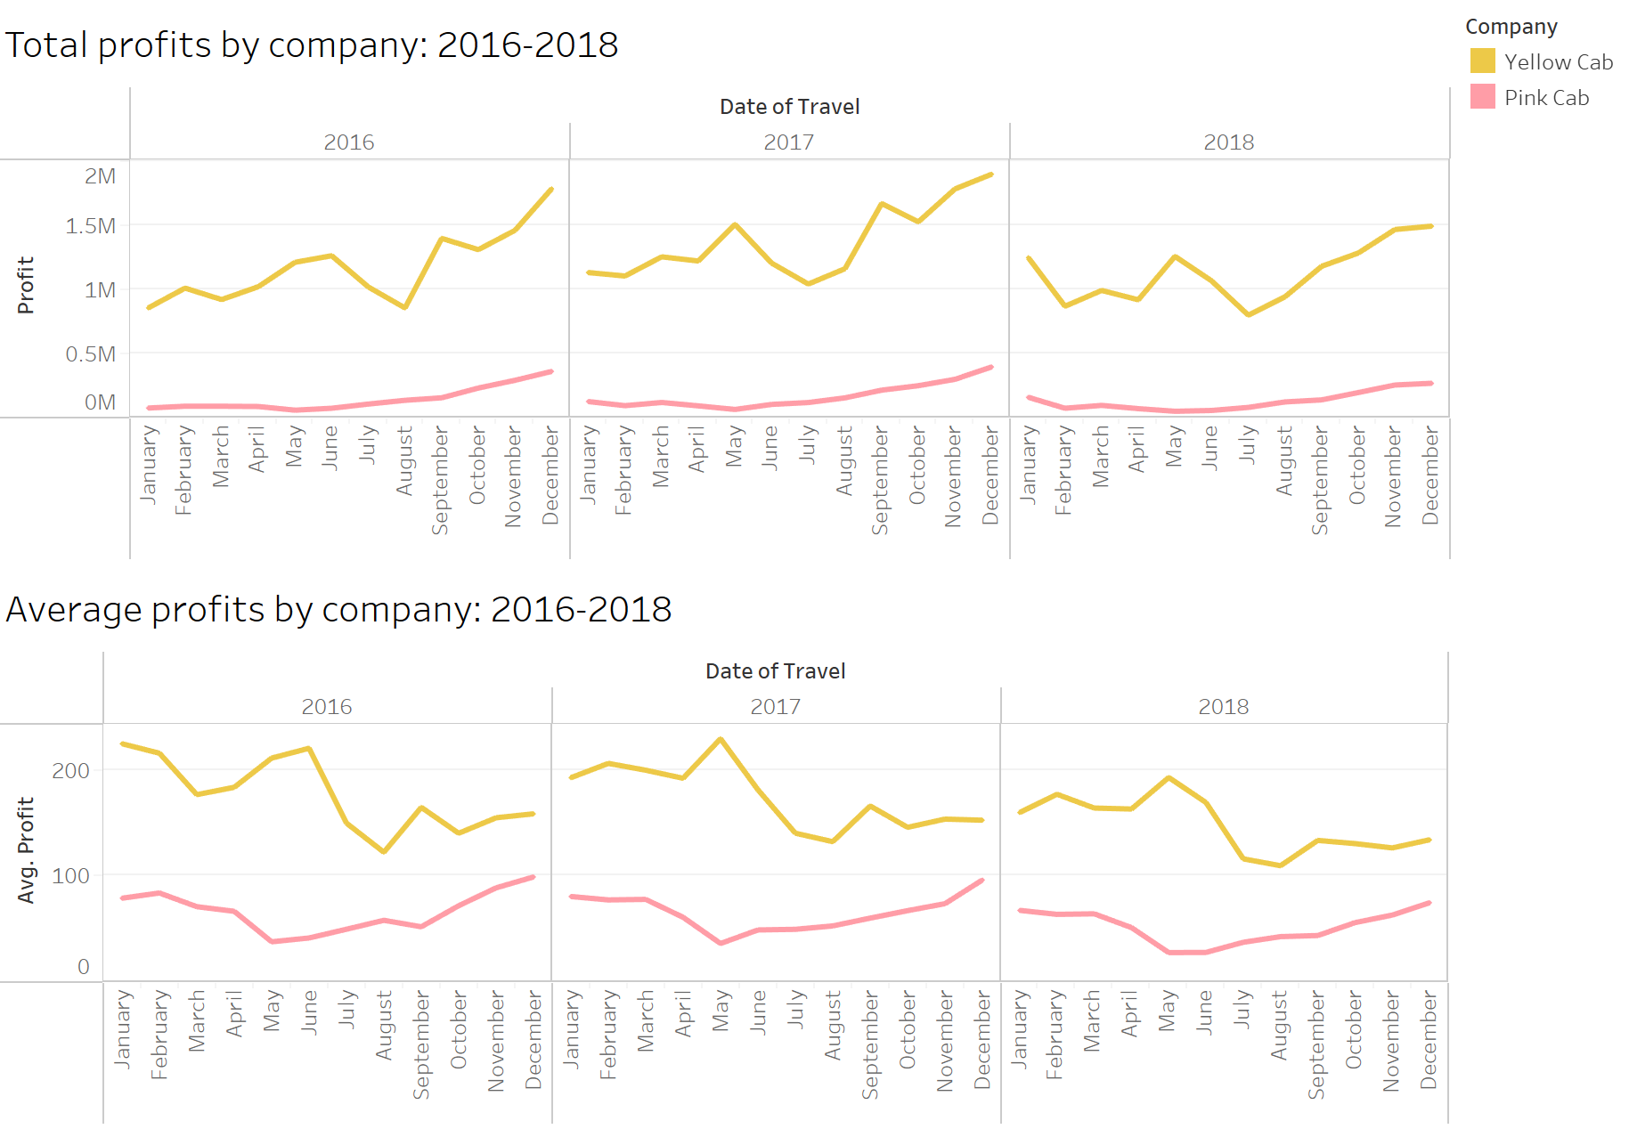
Exploratory Data Analysis
Company profits
Although Yellow Cab has the higher profits each month without fail, profits for both companies seem to be in slow decline. It is also worth noticing how Yellow Cab has harsh drops around July and August each year, while Pink Cab has them around May. Further analysis is needed to determine the cause of these losses.

Slide 13
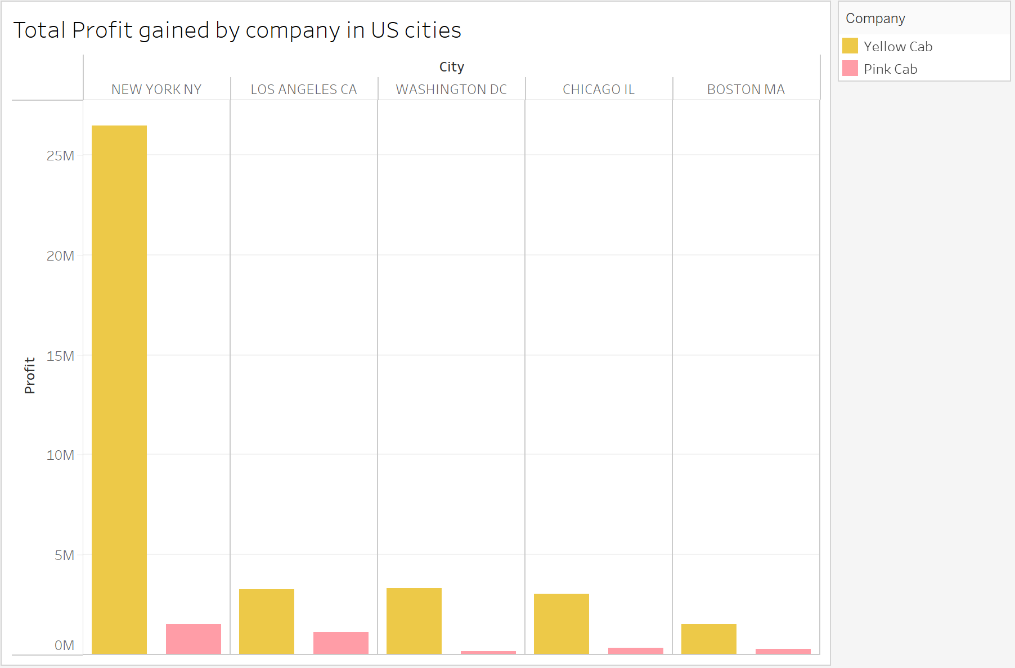
Exploratory Data Analysis
Company profits
Both companies seem to have gained the bigger proportion of their profits across the three years from their service in New York. This is especially true for Yellow Cab, which has gained more than 26.5 million in profits in NYC, whereas it has gained only 3.2 million in Los Angeles, its second most city with the highest profits.

Slide 14
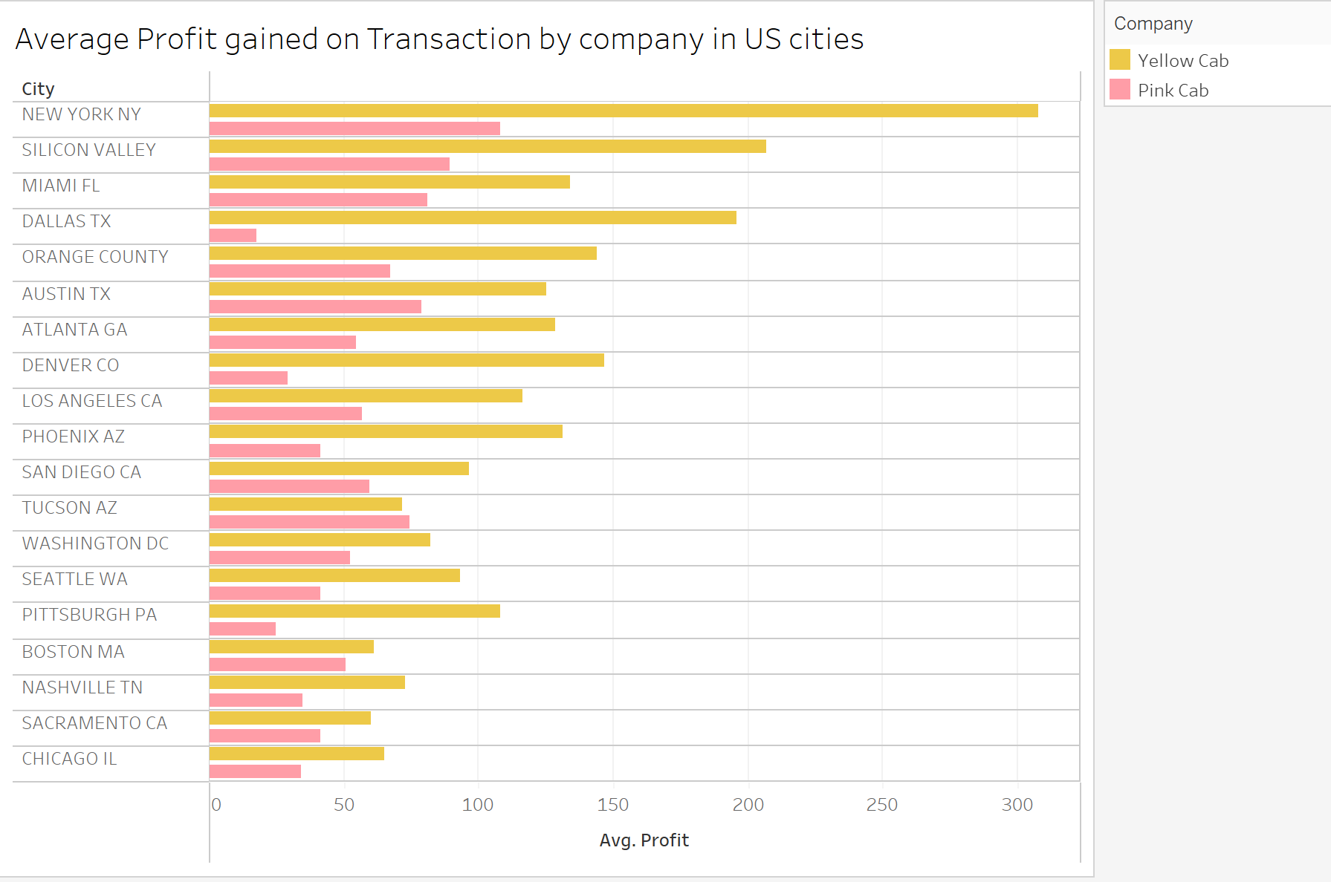
Exploratory Data Analysis
Company profits
Average profits in both companies seem to be the highest in New York, a Yellow Cab dominated city. Yellow Cab also seems to have consistently higher profits in most countries, while Pink Cab does not seem to have outstanding profits even in the cities where it wins in market share, which might help explain its disadvantage.

Slide 15
Exploratory Data Analysis
Company profits
Average profits in both companies seem to be the highest in New York, a Yellow Cab dominated city. Yellow Cab also seems to have consistently higher profits in most countries, while Pink Cab does not seem to have outstanding profits even in the cities where it wins in market share, which might help explain its disadvantage.

Slide 16
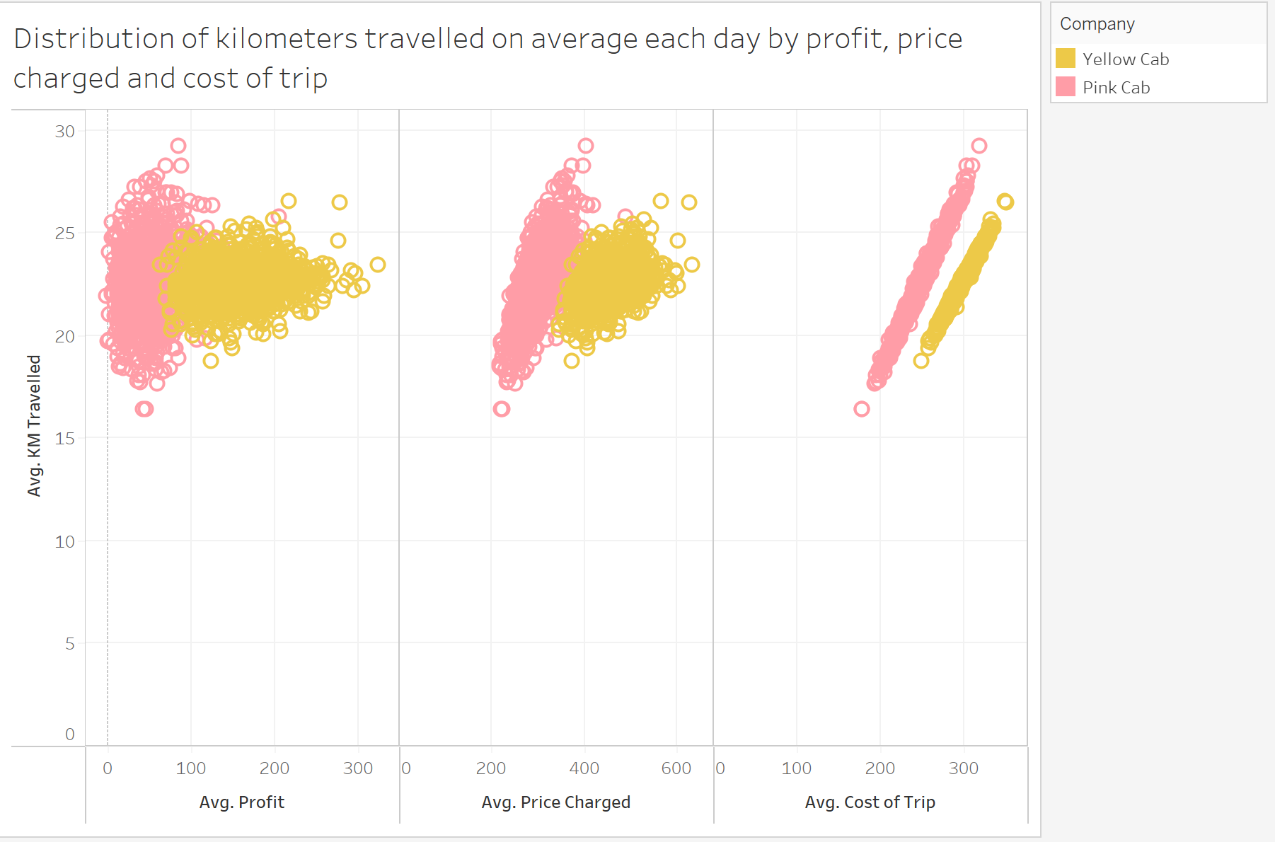
Exploratory Data Analysis
Company profits
Both companies' cost of trip seem to grow steadily the more distance is travelled, although Yellow Cab has a slightly less steep slope. Even more interesting, however, is the relationship between kilometers travelled and price charged on average each day. No matter how much more kilometers are travelled, Pink Cabs' price does not increase at the same rhythm Yellow Cab does. In fact, the behavior is completely opposite, with Yellow Cab having considerably more leeway to charge more for the same distance, thus consistenyl generating more profit while maintaining an average of 20 to 25 km travelled per day.

Slide 17
Exploratory Data Analysis
Company profits
Both companies' cost of trip seem to grow steadily the more distance is travelled, although Yellow Cab has a slightly less steep slope. Even more interesting, however, is the relationship between kilometers travelled and price charged on average each day. No matter how much more kilometers are travelled, Pink Cabs' price does not increase at the same rhythm Yellow Cab does. In fact, the behavior is completely opposite, with Yellow Cab having considerably more leeway to charge more for the same distance, thus consistenyl generating more profit while maintaining an average of 20 to 25 km travelled per day.

Slide 18
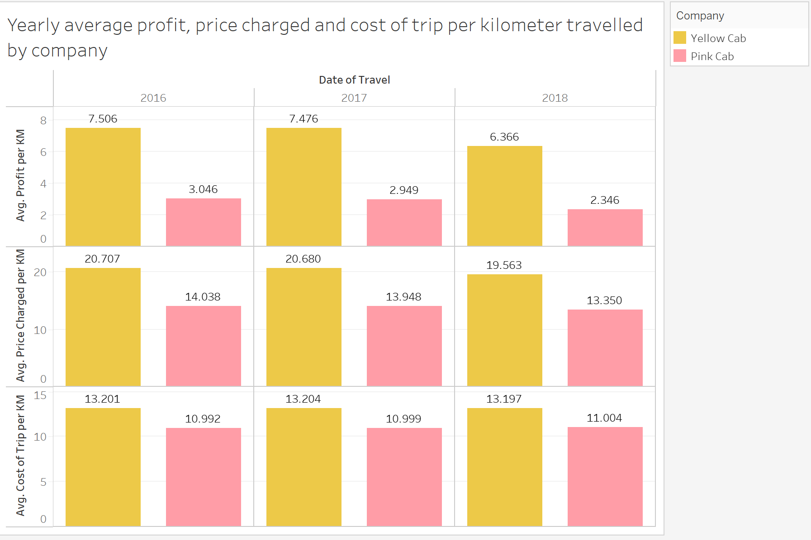
Exploratory Data Analysis
Company profits
Average profit for both companies seem to have decreased in the last year for both companies. Despite Yellow Cabs' efficiency in its pricing to distance ratio, we can see it will have to find a way to lower its static costs in future years to remain as competitive. While its average price charged per kilometer decreased in 2018, the average cost remained on a similar level to past years. Pink Cab is on a similar position, but it has a better trend on these variables than Yellow Cab.

Slide 19
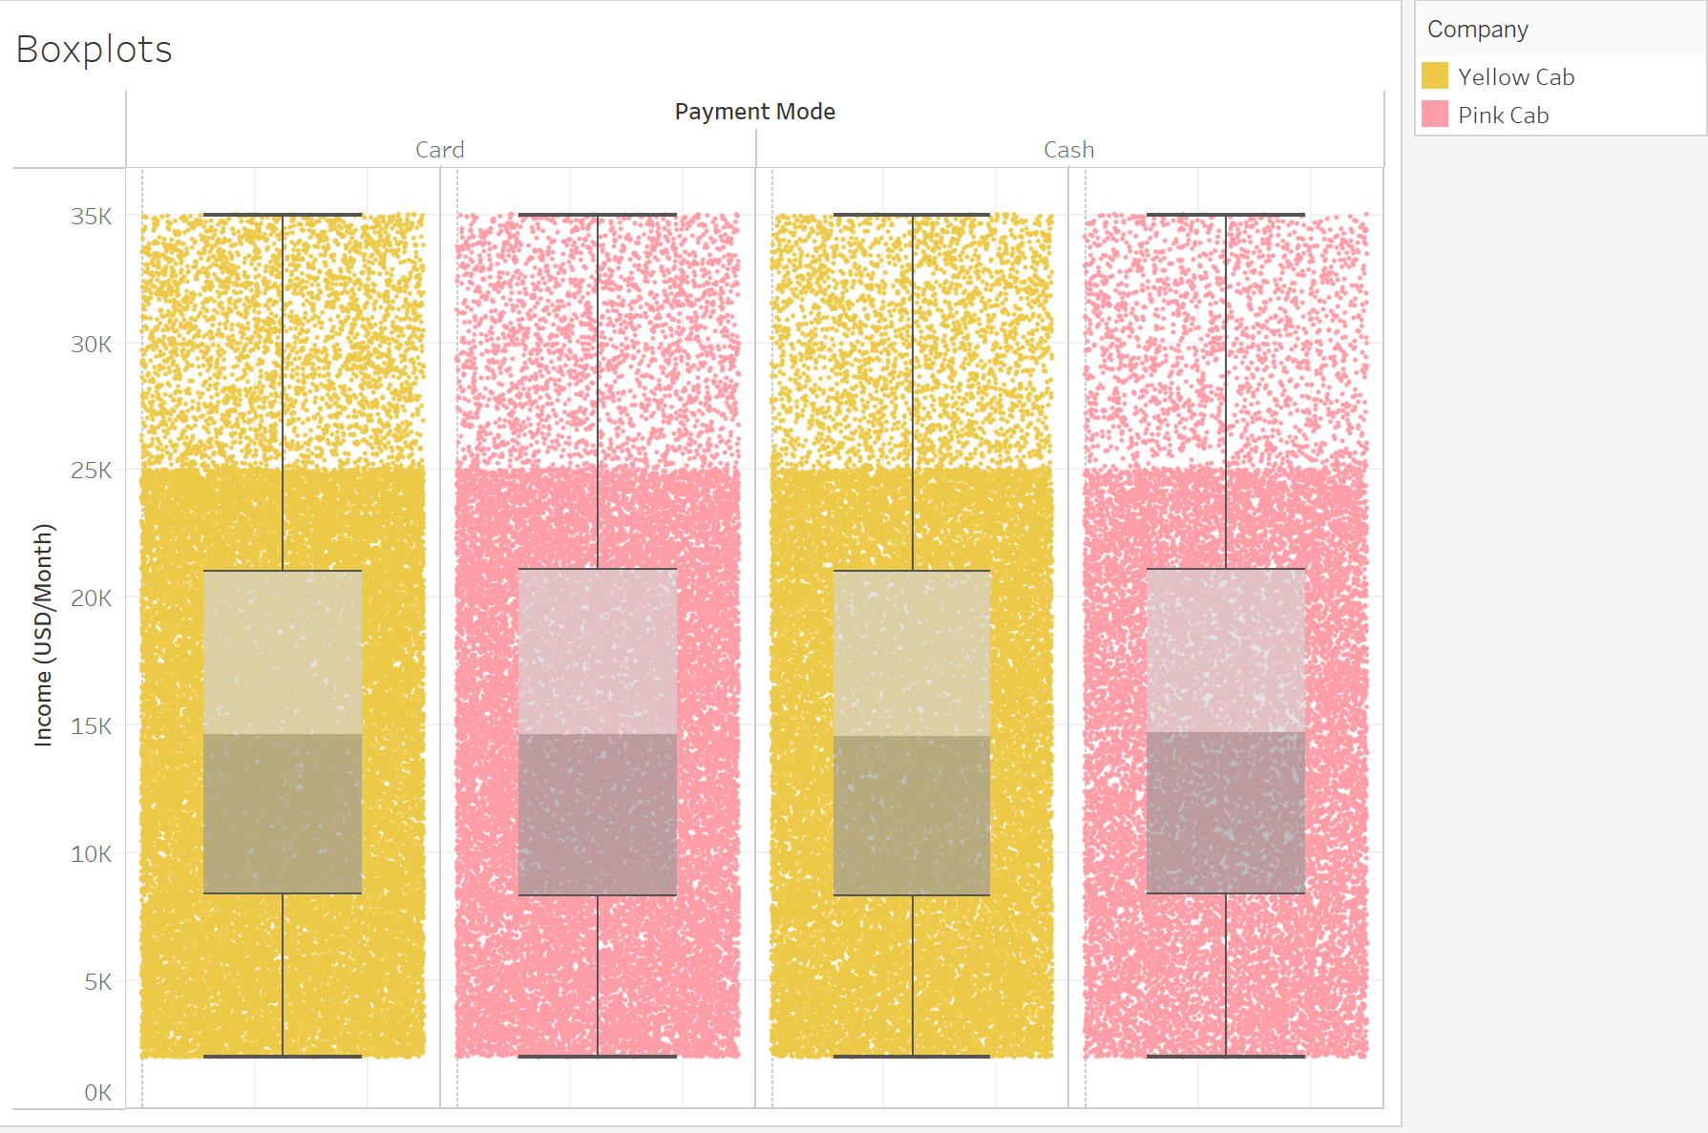
Exploratory Data Analysis
Other variables
Finally, we can see there is not much of a difference when it comes to the distribution of customer income between the two companies, nor does it affect the method of payment when using the services.

Slide 20
Conclusion and Recommendations
Although Yellow Cab does have to lower its cost to keep up its gains in the future, its merits over Pink Cab cannot be ignored, consistently making almost three times as much average profit per km every year, and having a bigger customer base on 16 cities, including the most profitable ones. Yellow Cab also seems to have a better pricing strategy. Because of the discussed evidence, we recommend investing in Yellow Cab, watching closely its limits in the seasonality of its profits and transactions and static costs.

Slide 21
Thank You

